Slide 1
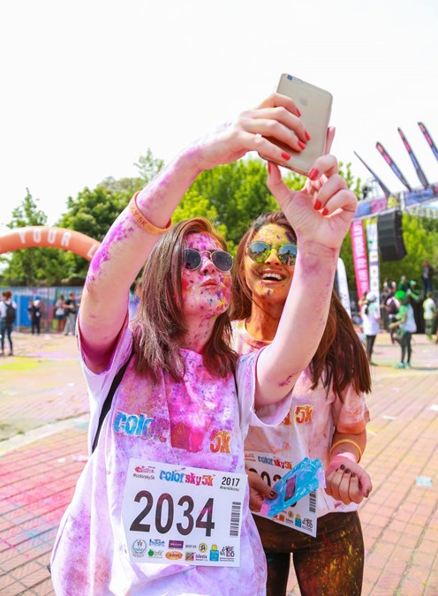
INTERdigitACTION harvesting experiential insights

Slide 3
…that certain special something and answers directly to peoples genuine needs
In this era of customer-centricity, beyond selling metrics
INTERdigitACTION identifies….

Slide 4
Great ideas emerge from authentic research
founded on truths and insights via:
real time behaviour…
…engaging with people to
capture in-the-moment
behaviours and truly understand why your initiative, product or service has made an impact on their lives…

Slide 5
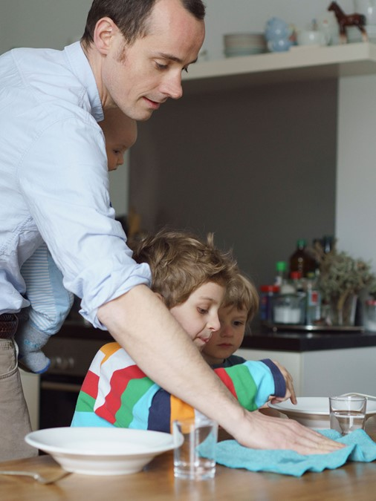
Participants embark on the INTERdigitACTION journey…
a digit@l ethnographic platform…
that documents and discovers life truths through their lens…
… encouraging implementation of
human-centered products and services

Slide 6
INTERdigitACTION is a online qualitative research solution that offers a better view and perspective into peoples [customers] everyday lives…
participants easily share their thoughts and feelings via selfie videos, pictures, creative tasks and 24/7 posting of their journey, which deliver rich, deep insights

Slide 7
How? via multiple device connectivity capabilities, on a versatile and user-friendly social media like platform
Why? to identify the story that builds service or product preference narrated through role and performance in life | in store - online | communication tonality ….. unveiling covert drivers at all touchpoints

Slide 8
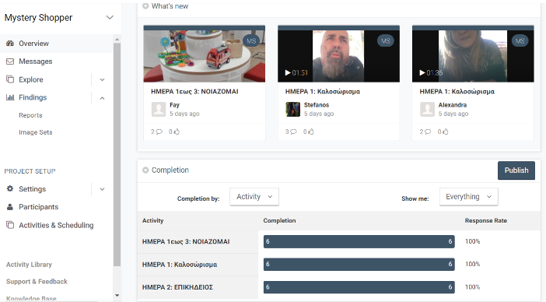
INTERdigitACTION DASHBOARD
View videos, posts and pictures
DAY 2: cleaning insights
DAY 1: Welcoming
DAY 3: HEALTH in HOME
DAY 1: Welcoming
DAY 2: cleaning insights
Daily tasks
DAY 3: HEALTH in HOME

Slide 9
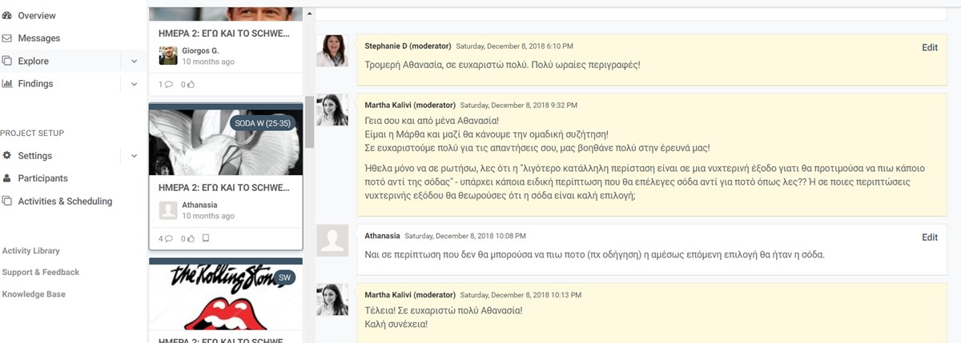
INTERdigitACTION DASHBOARD
Senior researcher interacts with team LIVE
Expanding on participant opinions, perceptions, feedback on stimuli, re-posting experiences etc.
CLIENT team can OBSERVE board activity and be an active ‘silent’ participant

Slide 10
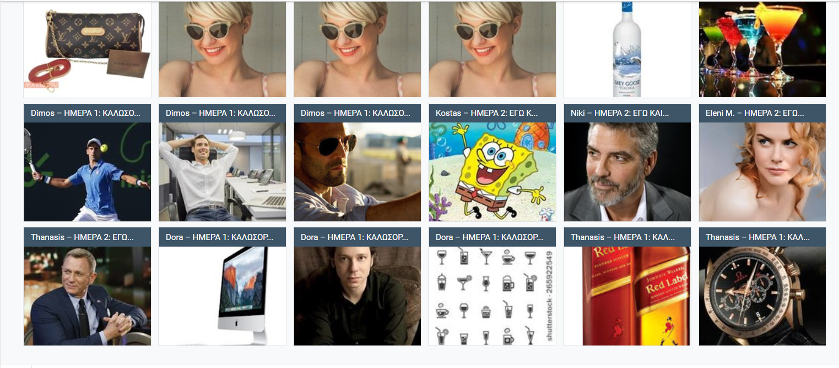
Projective techniques toward understanding brand DNA via creative activities

Slide 11
2 case studies
Going Smart!
role and impact of smart home technology in consumers’ daily life
Share the Care!
onboarding mystery shoppers to identify initiatives of retail CARE

Slide 12
Going Smart!
What? capturing the role of SMART HOME technology and impact on everyday life
Who? 20 panelists blogged & vlogged on a live feed | active participation for 9 days
How? interacting and conveying experiences that build value of Smart Home Technology through a live feed on one virtual hub→ journaling | posting | uploading | reacting

Slide 13
Going Smart!
Which are the main emotional hooks and entry point drivers?
Who are the influencers within the decision-making process?
Sources of information and role of retailers?
What do targets want to hear? Which are the unmet needs and gaps?

Slide 14
The panelists
Individuals that engage with Smart Technology [not HOME] i.e. wearables - POTENTIAL SH targets
Individuals who are MAINSTREAM users of Smart Home technology with adequate category proficiency
Individuals who are ADVANCED Smart Home technology users and exhibit high category literacy

Slide 15
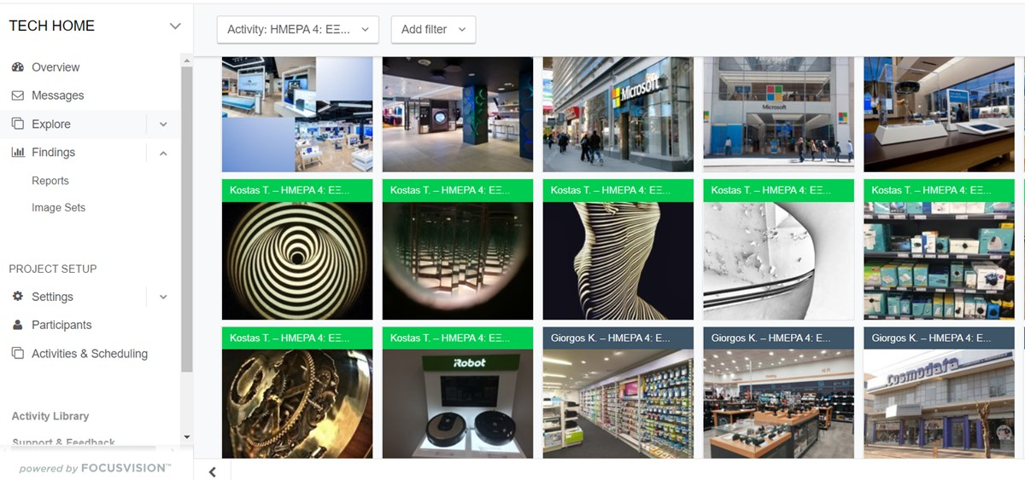
Example output
Ability to harvest a wide picture gallery of ‘in vivo’ insights at varying touchpoints

Slide 16
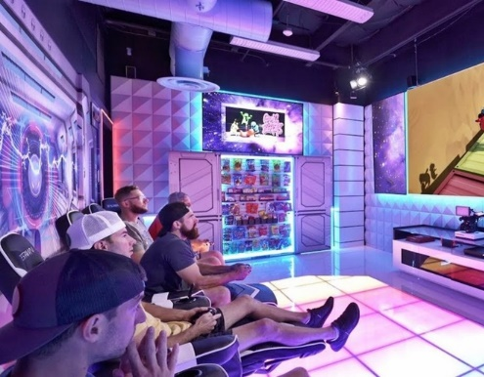
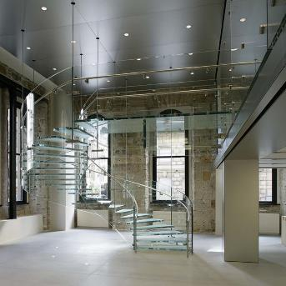
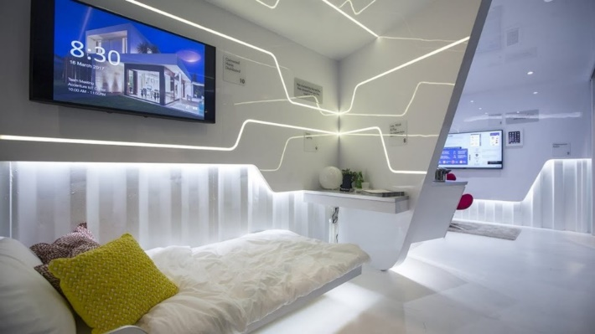
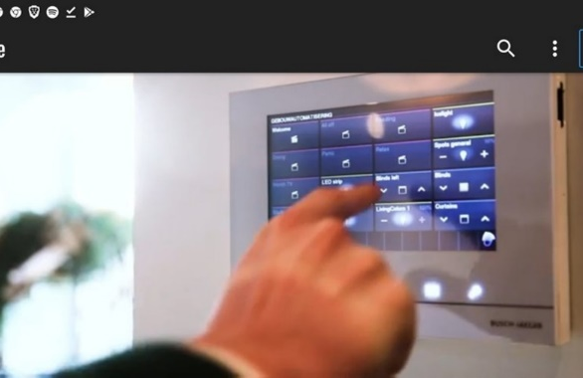
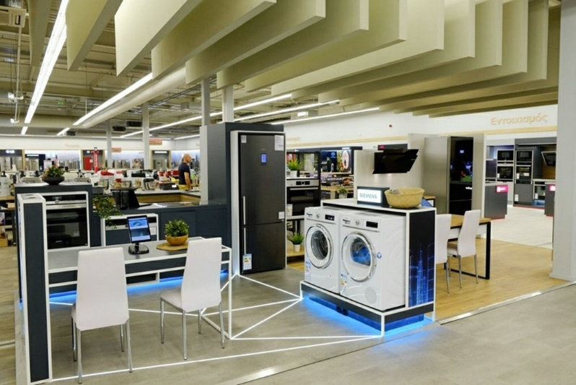
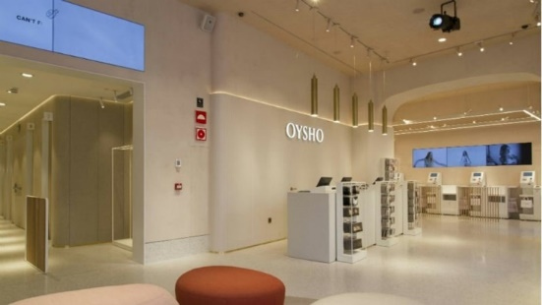
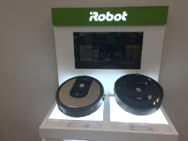
Potential targets perceive Smart Home technology as something futuristic. They also believe SH tech is way out of their league only understood by the tech proficient misconceptions manifest in absence of user friendly and relevant communication [at all touchpoints]

Slide 17
Smart [ & home] technology barriers in a cloud…
POTENTIAL
MAINSTREAM
POTENTIAL

Slide 18
Learning from proficient SH users and impact on their life
Simplicity Contentment Free time
Complexity Annoyance High effort
Fun - Bonding
Abundance - choice
Limited options
Boredom

Slide 19
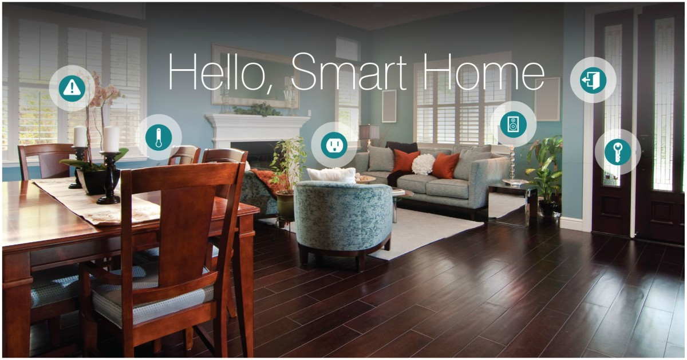
make Smart Home ‘part of their world’ at all touchpoints
easy – meaningful navigation
product benefits conveyed via storytelling – making it real
aesthetic - engaging display

Slide 20
engage customers along the smart home journey
1
Establish presence of Smart Home DNA | expertise as a Smart Home destination (on and off line)
2
Relate going Smart HOME to target proficiency | extroversion at all retail touchpoints which encourages ability to imagine and really live the Smart Home experience
3
Create experiential link of device feature with emotional ‘value for me’ | in store TRY ME or online information hub
4
Engage at ‘moment of truth’ with value offers or gifts (beyond price) i.e. a device extender or service, prompting for future purchases and retailer relationship

Slide 21
Share the Care!
What? On-site at POS capturing in-store activations of CARE within retail chains
Who? 10 mystery shoppers were invited to embark on an INTERdigitACTION journey… for 3 days
How? observing, documenting and engaging with customers – vlogging and interacting with Qual moderator ive feed on one virtual hub→ journaling | posting | uploading | reacting

Slide 22
Share the Care!
Harvesting insight on in store activations and behaviors that
amplify customer CARE

Slide 23
D’ WAVE | 2018
Evaluation of Green grocer
D’ ^{WAVE ‘18}
C’ ^{WAVE ‘18}

Slide 24
Pinpointing that ‘certain special something’

Slide 25
Insight tip
Locate and onboard that exemplary employee to train and guide sales colleagues!

Slide 26
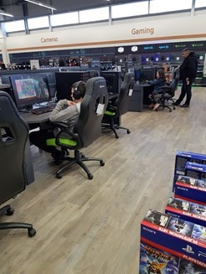
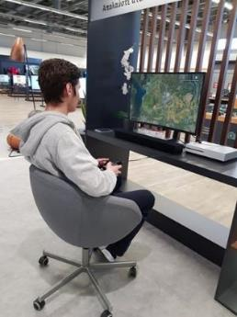
experiencing product 1st hand is key in engaging youth
experiential gaming corner!
play the game
feel the fun – socialize
interact with peer players
…was crucial to a positive purchase – potential buyers were reassured as to the right decision – low risk & felt good!

Slide 27
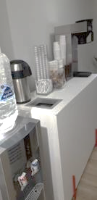
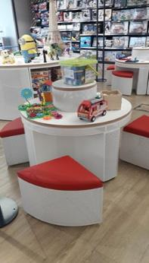
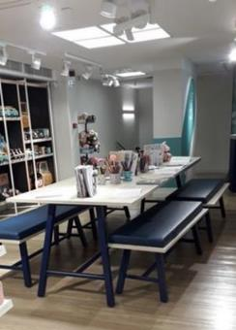
offering what shoppers needed most …at the right moment!
Peace of mind !
Kids had fun
Parents relaxed
Win -win kids corner!

Slide 28
Insight tip
any warm, personalized initiative …goes a very LONG way… in impacting customer loyalty

Slide 29
logistics and requirements…
10 –15 is a sufficient panel yet highly category and profile dependent. Could be up to 30
Usually when split across segments (users vs. non users | employees vs. management)
Tech familiar and Smartphone owners & photo and video uploading ability
Usually ‘on air’ for 5 - 7 days (could be 3 days or 1 month) highly project dependent (i.e. product placement and trial – could be for a duration of 15 days)
Reporting versatility – grids, heat maps, word clouds, video or photo collage

Slide 30
INTERdigitACTION and some closing thoughts…
Create extended interactions and discussions with your customers
‘Mine’ for that extra mile in view of implementing as a standard practice…moving on to the next insight!
Cultivate ‘out of the box’ flexibility and allow room for talented employees to rely on their ‘gut feeling’ and deviate from standard procedures.
Gain instant feedback on what people really think of new brand initiatives and solutions.
Ensure a deeper, emotional and customer centric understanding of what matters most and creates a true competitive edge!

Slide 31
We reach to the core of research to build powerful brands
RESEARCH
RESULTS
ANALYSIS & INTERPRETATION
PROPOSALS
THANK U!
STEPHANIE DAMAS
T:+302106128800 E: damas@globallink.gr www.globallink.gr

