Slide 1
Designing for behavioural change:
A behavioural science approach
April 9, 2021

Slide 2


Notes:
A common example of the say-do gap is exercise and getting in shape.

Slide 3

say-do gap

Slide 4



bridging the say-do gap with behavioural science
say-do gap

Slide 5

bridging the say-do gap with behavioural science
behavioural science
an interdisciplinary approach to studying human behaviour and decision making
investigates the systematic, yet predictable ways in which people act “irrationally”
allows us to pinpoint and test for the most salient drivers of behaviours without asking consumers to articulate them in their own words
say-do gap

Slide 6

understand behaviour
shape behaviour
Notes:
BSci provides us with frameworks, concepts, and tools to:
Underatnd behaviour
Shape behaviour

Slide 7

How can behavioural science help understand the “why” behind behaviour?

Slide 8
“Interventions that are underpinned by theoretically – driven behaviour change models are more successful and lead to longer lasting changes”
(Michie & Abraham, 2004)

Slide 9
why do we apply a behaviour change framework in research?
Using this framework increases our confidence that our behavioural diagnostics method has covered the relevant domains known to influence behaviour.
Provides a framework to facilitate accumulation of evidence
Identifies barriers and facilitators to change, and what needs to change
Identifies mechanisms of action. Generates evidence that can be used to design interventions and change behaviour

Slide 10
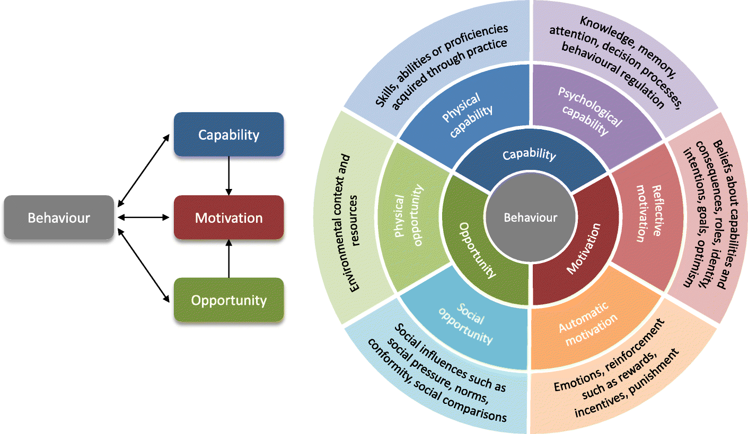
COM-B model of behaviour
capability
behaviour
motivation
opportunity
Michie et al. 2014

Slide 11
behavioural change theories
Self-efficacy
Theory of reasoned action
Theory of planned behaviour
Transtheoretical or stages of change model
Health action process approach
Michie et al., identified 83 theories of behaviour change in a cross-disciplinary review

Slide 12
COM-B model of behaviour
The COM-B model is a diagnostic framework that covers a wide range of behavioural determinants or influencers.
Capability and Opportunity address the question of whether a person can or can’t adopt a particular behaviour while Motivation addresses will they or won’t they adopt it
This framework suggests that for someone to engage in a particular behaviour at a given moment they must be:
  physically and psychologically able to (Capability),
  have the social and physical opportunity to do so (Opportunity)
  want or need to do the behaviour more than any other (Motivation).
capability
motivation
behaviour
opportunity

Slide 13
COM-B model is a framework for understanding behaviour around three key determinants:
Capability:
physical – a person's physical functioning to do something such as balance, skill, strength
psychological – a person’s mental functioning and knowledge to engage in a specific action
Opportunity:
physical - opportunity defined by the physical environment and time such as material and financial resources
social - opportunity defined by social influences and culture
Motivation:
reflective - conscious thought processes such as plan and evaluations
autonomic - habitual, instinctive, drive-related and affective process such as desires and habits
Notes:
For example to eat healthy or make healthy food choices -
I need to know what healthy food is. Have the capability to know what healthy food is
They must have the opportunity to eat healthy food – having the money to buy it or having a kitchen to prepare the food.
And I must WANT to or have the motivation to eat healthy food.
Social – is it culturally acceptable to eat healthy or are people going to laugh at you
Reflective - in terms of what the individual believes about healthy food. Do they believe eating healthy will benefit them.
Automatic – relates to factors such as wants and needs and impulses.

Slide 14
behaviour is part of an interacting system; it does not occur in isolation.
Behaviour does not happen in a vacuum but occurs within a context – the COM-B model is the starting point for understanding behaviour in the context in which it occurs.
By identifying what needs to change in the person and/or the environment, we can design an effective intervention to achieve the desired outcome.
capability
psychological of physical ability to do a behaviour
reflective and automatic mechanisms that activate a behaviour
motivation
physical and social environment that enables the behaviour
opportunity

Slide 15

How can behavioural science help shape behaviour?

Slide 16

behavioural
nudges
Notes:
When we understand the levers that shape decision-making, we can tweak the decision-making pathway and overarching experience to “nudge” decisions in the desired direction.
This means that we can change consumer’s perceptions and decisions by changing the context, stimuli, or experience.

Slide 17

choice architecture
Designing strategic changes in the context in which behaviour occurs
Alters people’s behaviour in a predictable way
Can be visual (e.g., size, colour), physical (e.g., placement, availability), language (e.g., tone, instructions), etc.

Slide 18

designing for behaviour change
Understand the factors that act as behavioural drivers or barriers in the categories of Capability, Opportunity and Motivation. All three of which drive behaviour.
Identify any barriers and facilitators to change, and what needs to change
Identify mechanisms of action – the component of the COM-B – that can become targets to be addressed by design.

Slide 19
FEAT
Frame
We frame the business challenge and objectives in behavioural terms. What behaviour(s) will drive the results and need(s) to be targeted?
Explore
We conduct exploratory research to understand the context in which the behaviour occurs and pinpoint the barriers and facilitators.
Architect
We design appropriate, custom nudges that target the mechanism of action.
Test
We use behavioural science methods to test and validate.

Slide 20

for a financial institution
to understand barriers to new product adoption
created a set of strategic recommendations for targeted communications and messaging

Slide 21

for a gaming organization
to explore how to move offline consumer behaviour online during COVID-19
created a set of strategic recommendations for service and product design features

Slide 22


Slide 23
DR. MARINA RAIN
marinarain@rsginc.net
ZLATA VOLFSON
zlatavolfson@rsginc.net

